Slide 1

Concept of Deen (Religion) in the light of Holy Quran and Sunnah
Week 2
(Surah Al-Baqara 284-286)
Course Instructor
Dr. Muhammad Nawaz

Slide 2
Content
Concept of Deen (Religion) in the light of Holy Quran and Sunnah
Study of selected text on Faith
Verses of Surah Al Baqarah ( verse no. 284-286)

Slide 3
Concept of Deen
What is Deen (Definition and explanation)
Different between Deen and Mazhab
Types of Religion (Deen) (Revealed religion, Non Revealed religion with examples)

Slide 4
Study of selected text on Faith
What is Faith (definition and explanation)
Steps of Faith : Three steps verbal faith, acceptance by heart, practical faith; with examples.

Slide 5
Verses of Surah Al Baqarah ( verse no. 284-286)
Meaning of Al Baqarah , Reason for naming, introduction of Surah Al Baqarah.
Significance of last two verses of Surah Al Baqarah.( Gift from Allah Almighty to Prophet Muhammad SAW at the time of Mairaj un Nabi)
Verses of Surah Al Baqarah(284-286)

Slide 6

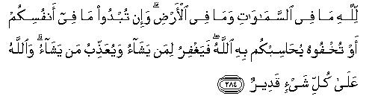
In the name of Allah, the most Gracious , the most Merciful. Verse No. 284
To Allah(SWT) belongs whatever is in the heavens and the earth. Allah(SWT) will call you to account for what is in your minds whether you disclose it or hide it. He, however, had full authority to pardon or punish anyone. Allah (SWT) is able to do everything.

Slide 7
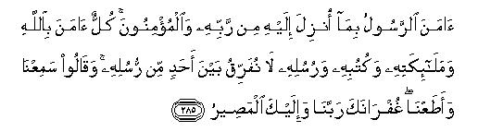
Verse No. 285
The Messenger believed in the Guidance which has been sent
down to him from his Lord (Allah (SWT), and those who believe
in the Messenger have also sincerely accepted the same. They all
believe in Allah (SWT), His Angels, His Books and Messengers. And
they say, "We do not discriminate against any of His Messengers.
We have heard the Message and submitted to it. Our Lord, we
look up to You for forgiveness, for to You we shall all return.“

Slide 8
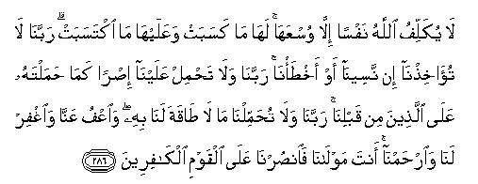
Verse No.286
Allah(SWT) does not burden any human being with a responsibility heavier than he can bear. Everyone will enjoy the fruit of the good that one has earned and shall suffer for the evil that one has committed. (O Believers, pray like this to Allah SWT :) "Our Lord, take us not to task if we forget and lapse into error inadvertently. Lord! Lay not on us the kind of burdens that You had lain on the people before us. Lord, lay not on us the kind of burden that we have not the strength to bear. Be kind to us, forgive us and show mercy to us. You are our Protector: help us against the disbelievers.“(Ameen)

